Slide 1
Session 1 - BASIC Data structures
Vivek & Deepak

Slide 2
Objectives
To understand Abstract Data Types such as Linear Data Structures
1
Implement ADTs using Python
2
To Identify Use Cases for these Structures
3

Slide 3
LINEAR DATA STRUCTURES
Linear Data Structures arrange and traverse the data elements in a sequential approach
1
Examples of simple yet powerful linear data structures are Stacks, queues, deques, and lists
2
Since they have a linear structure, the entry and exit point for the data elements is of great importance
3

Slide 4
STACKS
One of the most common data structure, sometimes referred to as “Push-down-stack”
1
It is an ordered collection of data items (can be heterogenous) that follows the “LIFO” ordering principle
2
Data elements are added and removed from one end of the structure, called the “Top”
3

Slide 5
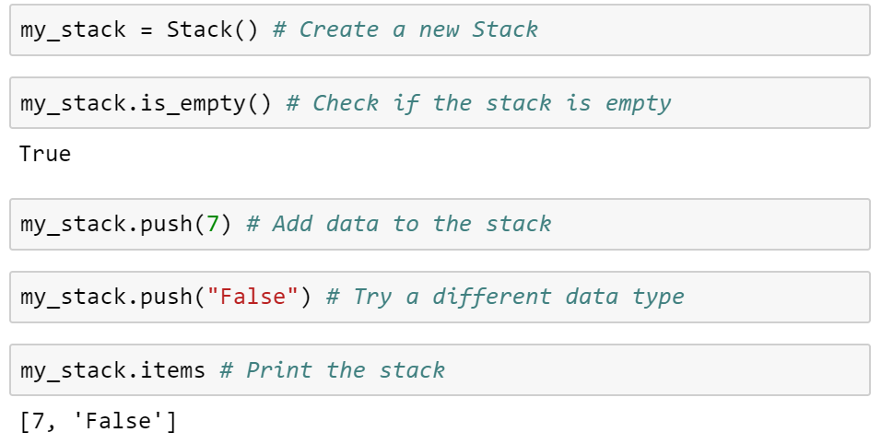
Stack operations

Slide 6
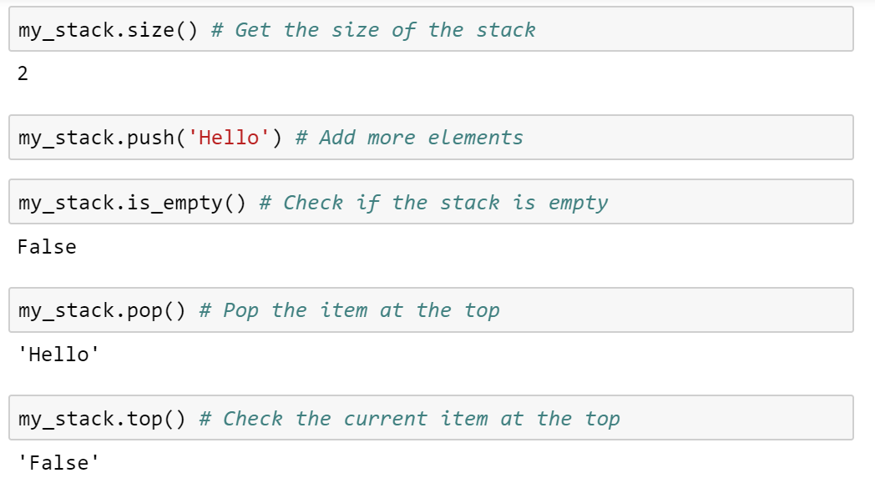
Stack operations Continued..

Slide 7
The operations in summary
Stack() creates a new stack that is empty. Requires no parameters and returns an empty stack.
push(item) adds a new item to the top of the stack. Requires the item as a parameter and returns nothing.
pop() removes the item at the top of the stack. Requires no parameters and returns the item. The operation modifies the stack.
top() returns the item at the top of the stack but does not remove it. Requires no parameters. The operation does not modify the stack.
is_empty() checks if the stack is empty. Requires no parameters and returns a Boolean value.
size() returns the number of items in the stack. Requires no parameters and returns an integer.

Slide 8
LETS GET TO THE IMPLEMENTATION

Slide 9
Lets build a stack
A data structure is a physical implementation of an abstract data type. Remember that an ADT is only a Mathematical Model.
1
An abstract data type can be best given a physical structure using the power of Object oriented programming.
2
Since a Stack is a collection of elements, we could utilize the in-built advantages and simplicity of the primitive collection types in Python.
3

Slide 10
REASONS TO USE OBJECTED ORIENTED APPROACH
Classes provide a common template for creating instances of the same type and adding behavior to them.
1
Behavior can be defined by functions created within the class statements.
2
Functions attach attributes to the class object that can be inherited by all instances and subclasses.
3

Slide 11
The constructor
class Stack:
def __init__(self):
self.items = []

Slide 12
ALL THE OPERATIONS
def is_empty(self):
return self.items == []
def push(self, item):
self.items.append(item)
def pop(self):
return self.items.pop()
def top(self):
return self.items[len(self.items)-1]
def size(self):
return len(self.items)

Slide 13
Alternative implementation
We could choose to implement the stack using a list where the top is at the beginning instead of at the end.
This ability to change the physical implementation while maintaining the logical characteristics is an example of abstraction at work.
The key differences in the implementation are,
1. The append and pop() operations are both 𝑂(1) in the original implementation.
2. It will perform push and pop in constant time no matter how many items are on the stack.
3. The performance of the alternative implementation suffers in this area; for a stack of size 𝑛, the insert(0) and pop(0) operations will both require 𝑂(𝑛).

Slide 14
SO WHAT ARE THEY USED FOR?
EXPRESSION EVALUATION
Examples,
1. Symbol Balancing.
2. Evaluation of Infix, Prefix and Postfix Notation.
1
BACKTRACKING
Examples,
1. Undo operation.
2. Browser URL Tracking.
2
COMPUTATION
Examples,
1. Reversing a string.
2. Numerical Converters.
3. Recursive Functions.
3

Slide 15
Complete implementation
https://github.com/vivek14632/Python-Workshop/tree/master/Data%20Structures%20%26%20Algorithms/Chapter%203/Abstract%20Data%20Structures/Stack

